Slide 1
CENSUS INCOME A PROJECT ON TABLEAU, MACHINE LEARNING AND DEEP LEARNING
BY
SIMRAN SIROYA
MANGIREESH POTNIS

Slide 2
PROBLEM STATEMENT & DATA DESCRIPTION
Based on various characteristics of an individual we aim to predict whether he or she would earn greater than or less than $50,000 per year. The prediction 1 (for less than $50K) and 0 (for greater than 50K) is done for each individual. There are 41 attributes for 299,285 instances.
There are 13 numerical variables, 28 categorical variables and 1 target variable

Slide 3
PREPROCESSING THE DATA -
Steps carried out for data preprocessing :
Concatenating the train and test dataframe
Removing any duplicate rows from the dataset
Dropping irrelevant features from the dataset
Removing the outliers from the dataset
Creating bins for date processing of categorical columns

Slide 4
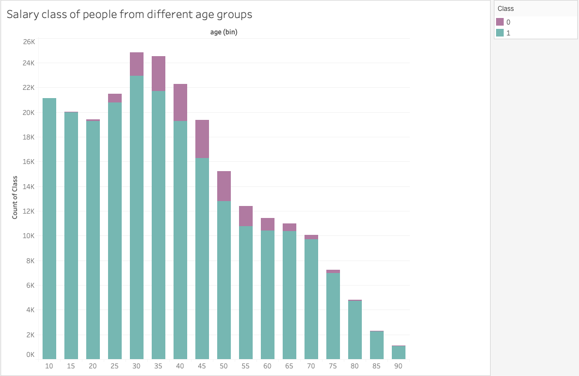

Slide 5
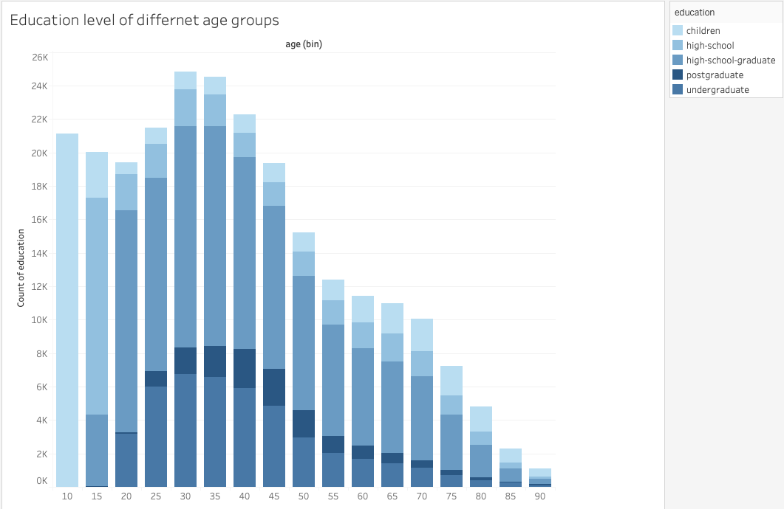

Slide 6
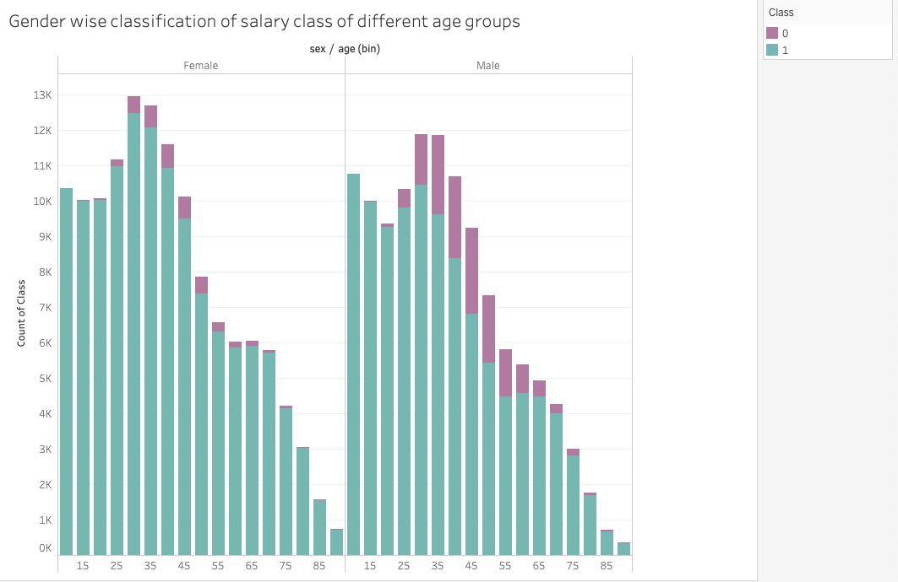

Slide 7
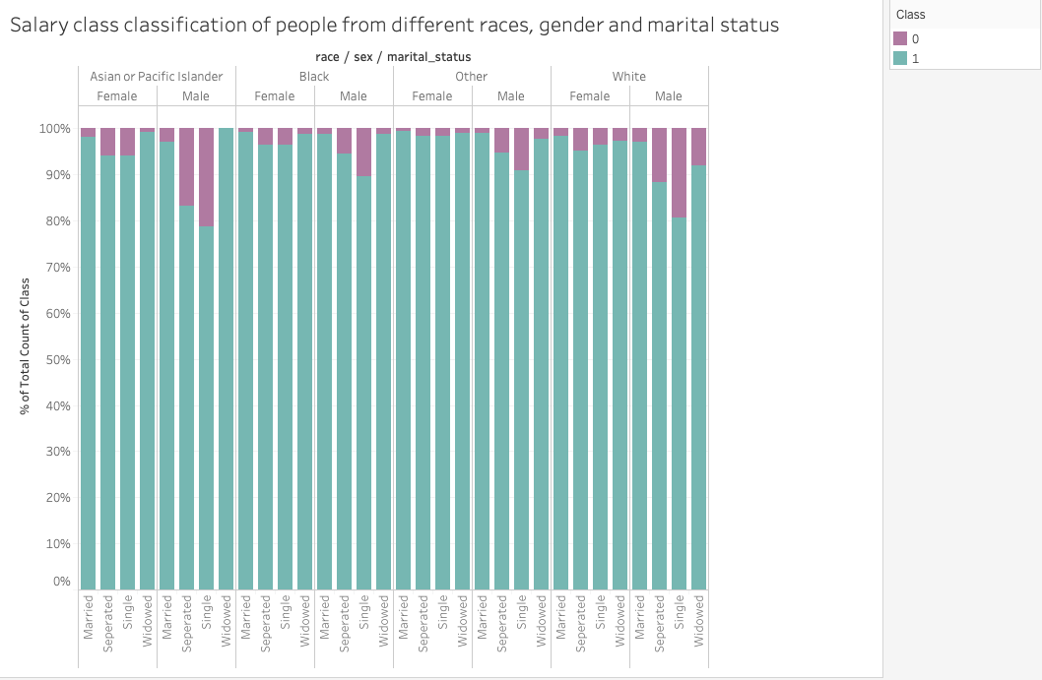

Slide 8
